Slide 1
Note Taking and Note Making
Session 2 /
09 January 2021

Slide 2
Refresh
Importance of Soft Skills
Importance of Communication Skills
Note Taking
Note Making
Training Points

Slide 3
Definition
You take notes in lectures or seminars, writing down what other people are saying for future reference.
You make notes from reading books, journals, any form of text. In this case it is important that you do not plagiarise without meaning to, so record the reference before you make any notes, and make sure you use quotation marks “...” if copying

Slide 4
Scope
Listening – Lectures / Presentations / Lab Work / Seminars
Reading – Books / Journals / Web Sources

Slide 5
Training
Essential vs Non-Essential
Short cut abbreviations / code uses

Slide 6
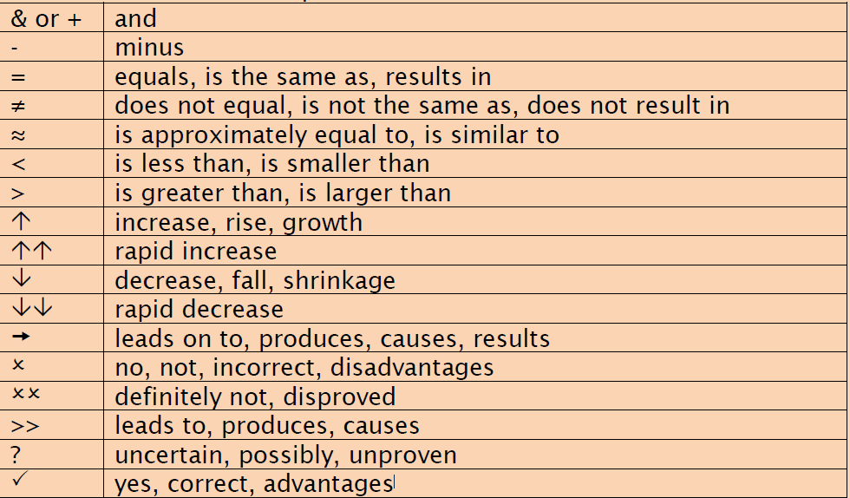
Abbreviations

Slide 7
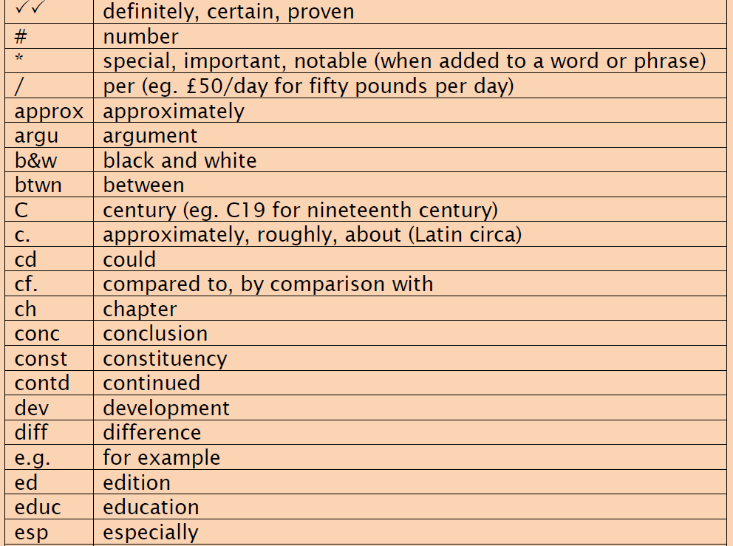
Abbreviations (cont)

Slide 8
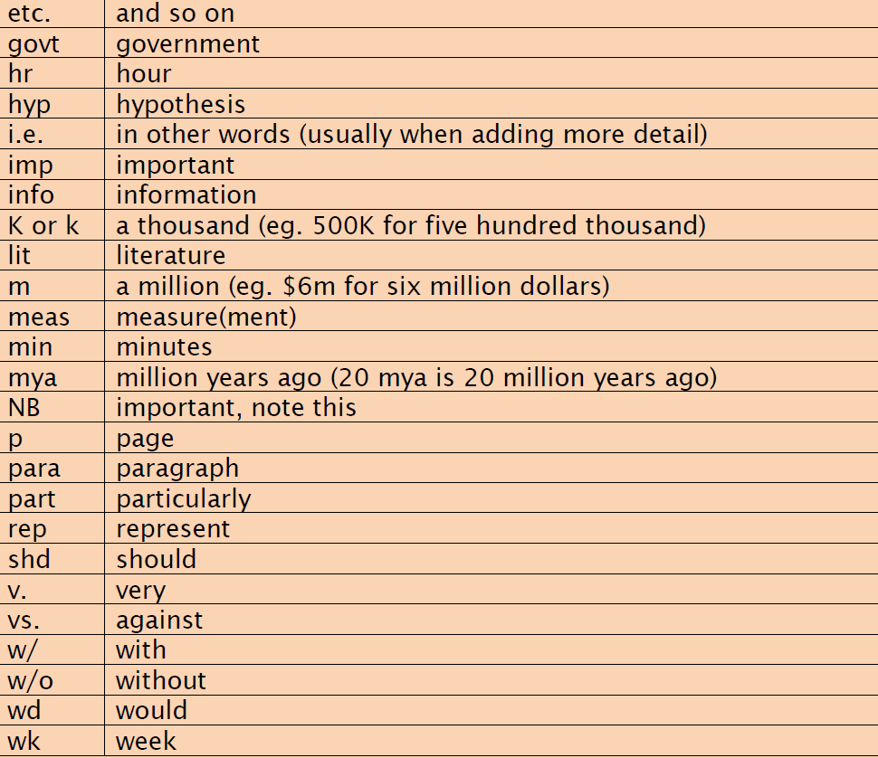
Abbreviations (cont)

Slide 9
Aspects
Use your own words
Be concise
Use abbreviations, phrases and key words, not sentences
Date and reference notes clearly
Number pages and points
Use headings and subheadings
List details
Use boxes, underlining, colour coding, CAPITALS and highlighting
Use arrows to show links between sections
Use diagrams and drawings
Leave a margin and plenty of space between sections
Use a well-spaced layout

Slide 10
Uses
Making notes helps you to:
stay active and engaged during your lectures, reading and revision
understand what you are learning and clarify your thinking
be selective and identify key ideas
remember the material
organise your ideas and make connections
plan and structure written assignments
review and revise before exams

Slide 11
Formats
Linear Notes
Mind Maps
Flow Charts
Tree Diagrams

Slide 12
Formats
Linear Notes
Key words and phrases.
Headings and sub-headings, underlining, use of bold.
Numbering or bullet points
Phrases
Abbreviations
Margins to put in additional points
Spacing
One side of the page only
Useful when there is a clear structure

Slide 13
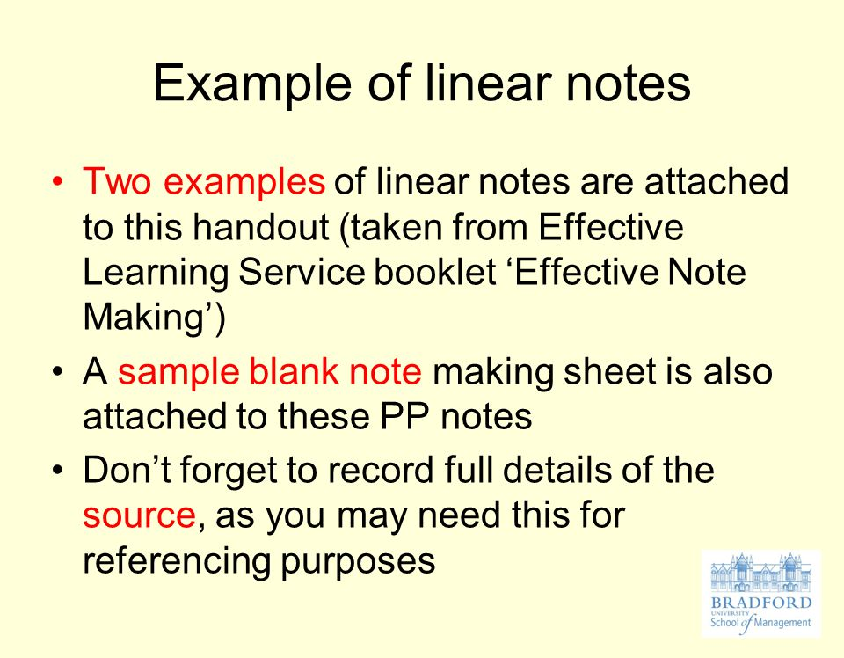
Linear Notes (cont)

Slide 14
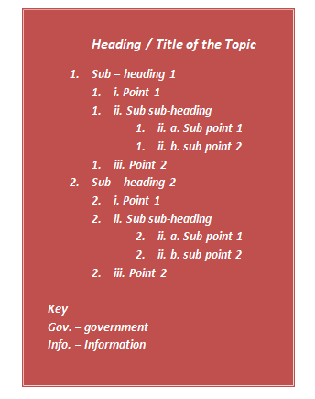
Linear Notes (cont)

Slide 15
Formats (cont)
Mind Maps
A pictorial way of organising your thoughts and ideas
Resemble the way the brain works, with the topic in the middle of the page and the ideas flowing outwards
The visual nature of the notes can make it easier to understand and remember information
Writing is kept to a minimum and links between sections can be more obvious
Use of colour, diagrams, pictures, and symbols

Slide 16
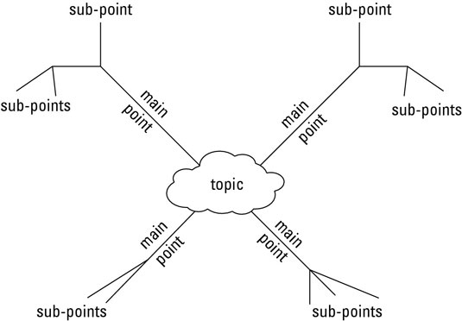
Mind Maps (cont)

Slide 17
Formats (cont)
Flow Charts
Flow charts are easy-to-understand diagrams showing how steps in a process fit together.
Define and analyse processes
Build a step-by-step picture of the process for analysis or discussion

Slide 18
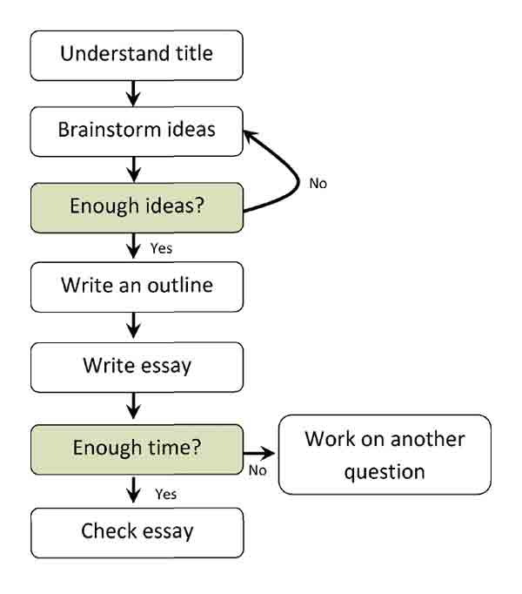
Flow Chart (cont)

Slide 19
Format (cont)
Tree Diagrams
This looks like a family tree but would need practice to use quickly in a lecture; it is more suited to making notes from a book or article.

Slide 20
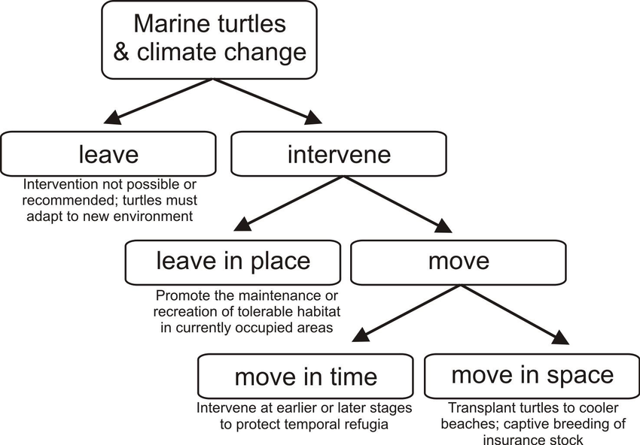
Tree Diagrams (cont)

Slide 21
Steps to Effective Notes
There are three stages to making effective notes: before, during, and after
Before: Prepare by finding out what you need to know and what the purpose of the reading or lecture is
During: Note down main ideas and keywords. Find techniques that work for you
After: Reflect and review and then organise your notes

Slide 22
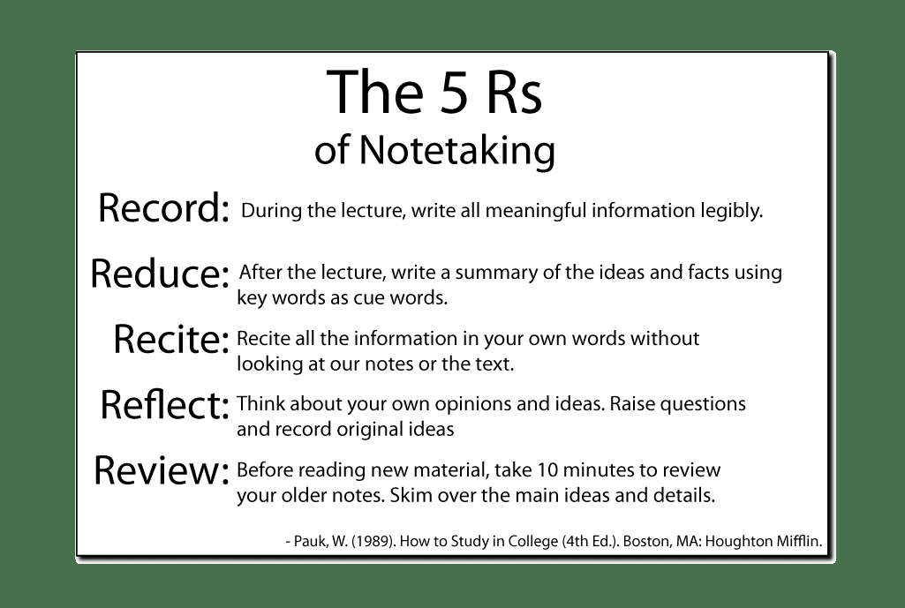
5Rs of Note Taking

Slide 23
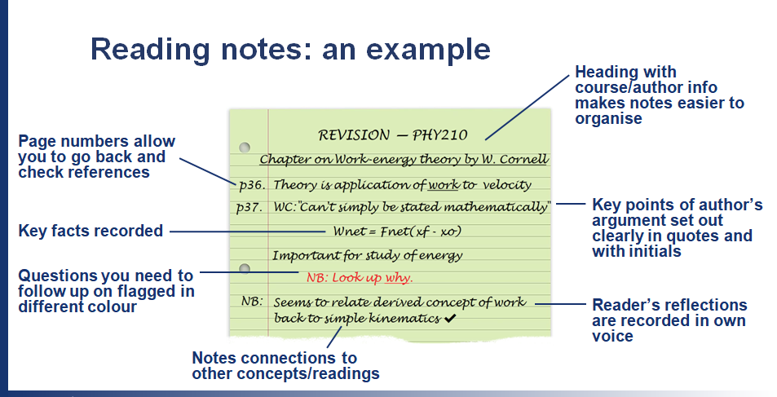
Reading Notes – Example

Slide 24
Summary
Importance of Note Taking / Note Making
Formats for Note Taking
Linear Notes
Mind Maps
Flow Charts
Tree Diagrams
Aspects of Note Taking

Slide 25
Last Word
Best Wishes for a Soft-Skilled enhanced Career

